Slide 1
How to Access Pearson Math
1. Sign on to Classlink. https://launchpad.classlink.com/chino.
2. Click on Pearson Easybridge.
3. You will be automatically logged in. IF there is an issue, sign in using the following information.
Username: district username@chino-ca
Password: district password
4. When you are logged in, click “Pearson Realize.”
5. When you click “Browse”, you will find the digital textbook, materials, and resources.
6. “Classes” will take you to your weekly assignments.

Slide 2
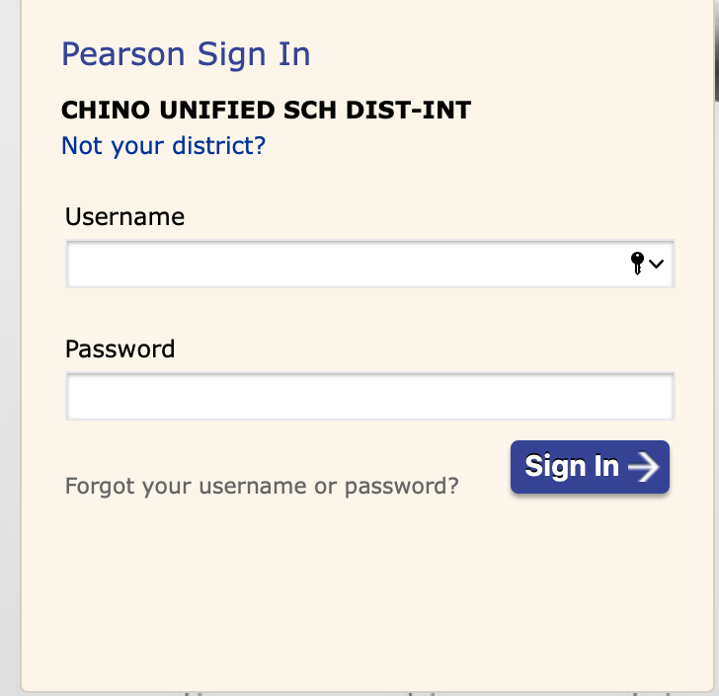
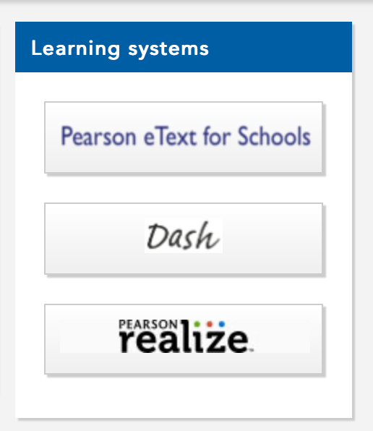
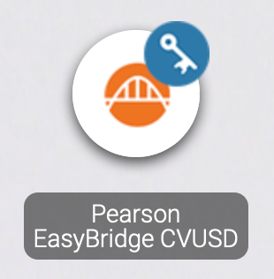
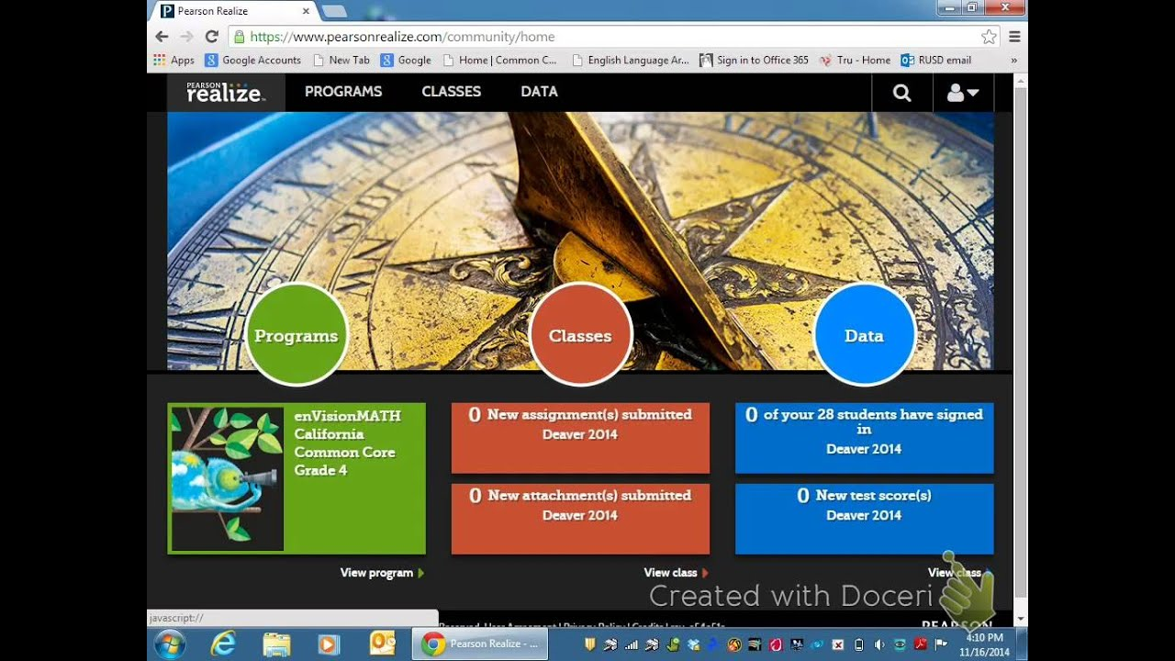
1
2
3
4

